Slide 1
Boilerplate Logging
Evan Lee
University of Colorado
evan.n.lee@colorado.edu

Slide 2
Definitions
boil·er·plate (n.) - standardized pieces of text for use as clauses in contracts or as part of a computer program.

Slide 3
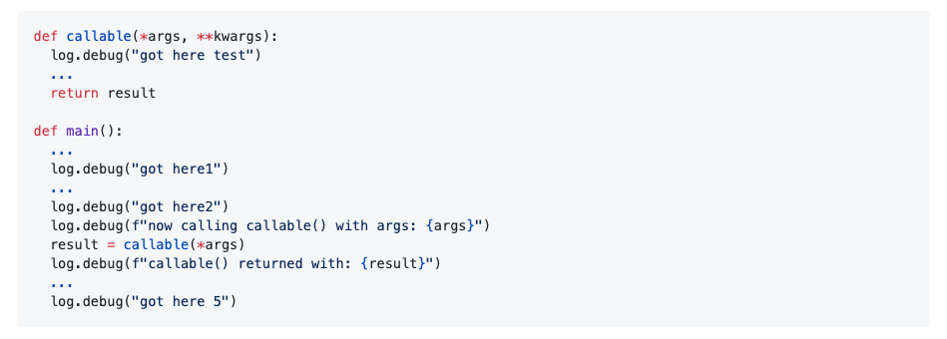
egregious example of manual boilerplate logging in action, Python3.7

Slide 4
Time to get the “got here” out of here.

Slide 5
Boilerplate logging use cases
Tracking the state of a program store
Track and display modifications to state & inputs and outputs of callables
Tracing the state of a program execution
“Got here” example
Trace program state leading up to an error or exception
Tracking operation durations + timestamps

Slide 6
Prevalence in industry

Slide 7
Corpora Criteria
Open Source
Last commit/pull request within last 90 days
GitHub “used by” metric of at least 1000
Widely recommended as library/plugin of choice for given functionality
Made use internally of some sort of logging
Closed Source
Last commit/pull request within last 90 days
More than 3 contributors
Made use internally of some sort of logging
Notes:
4 open source and 4 closed source code bases

Slide 8
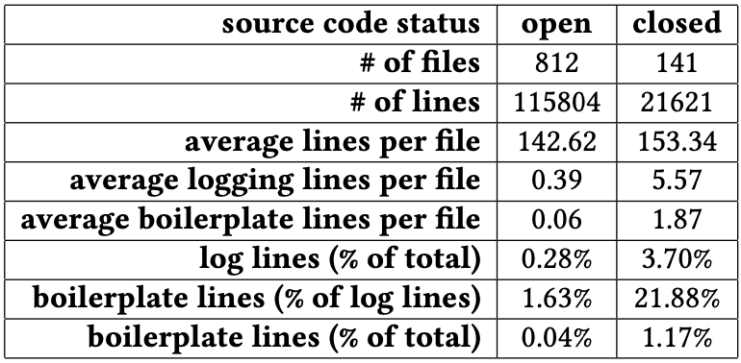
Notes:
Open source -- mention “good neighbor” aspect of open source libraries.
Segue: only 0.04% of total lines of code; who cares? Well, developers do: next slide

Slide 9
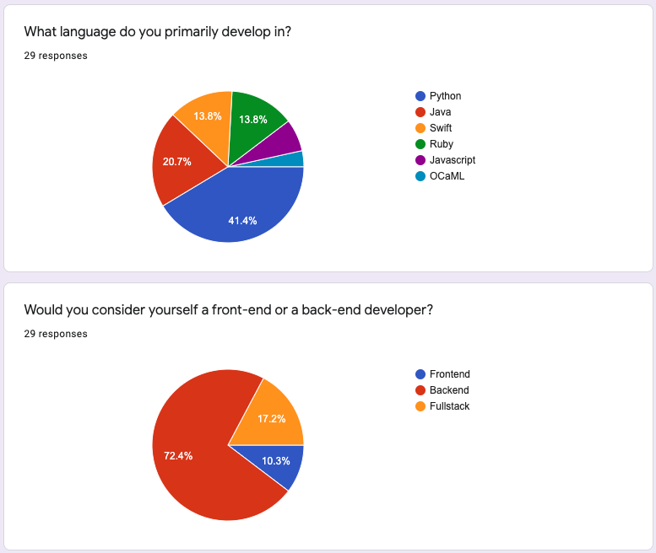
Survey
29 total
Notes:
Survey target audience: friends and colleagues in the industry (i am a python backend developer, so are a lot of my peers)

Slide 10
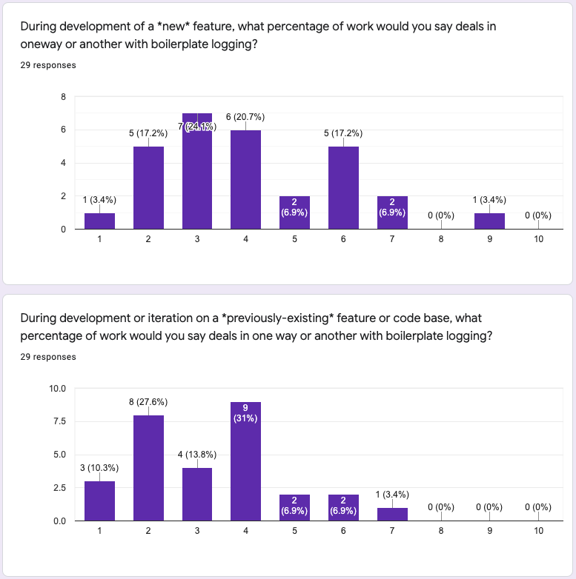
Survey
29 total
Notes:
Point: anywhere from 20-40% of time is spent on boilerplate logging

Slide 11
“Hidden cost”
Developers in all disciplines and in all languages use some form of boilerplate logging during active development
Cost sometimes not measurable in hard metrics like lines of code
Charged twice: once to write boilerplate logging statements, once to clean them up before committing

Slide 12
Boilerplate logging is a hidden cost that developers pay daily.

Slide 13
python-boilerplate-logger

Slide 14
Boilerplate logging library
Python3.7+
Accessible via decorator
Standardized log messages & formats
Uses natural Python logging library under the hood
Allows for natural & familiar configuration interface
Mix and match into application logs

Slide 15
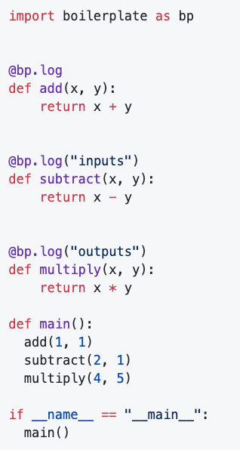


Slide 16
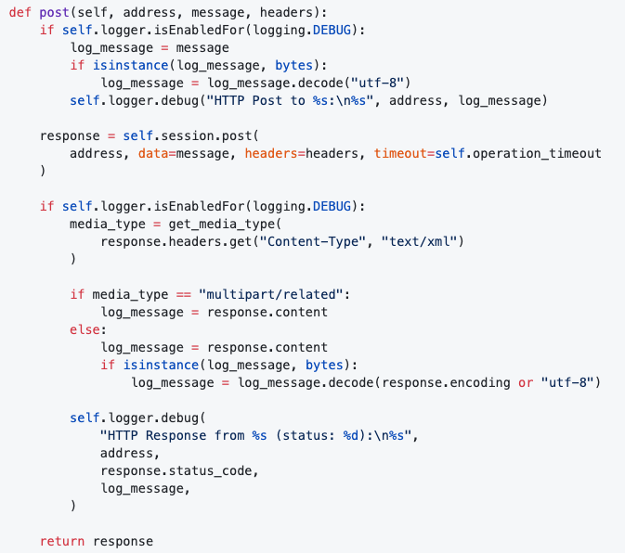
python-zeep, transports.py (47-84, df383021e31372c111bc26cbf2e4535deaee04e)
Notes:
Logical lines of code: 15

Slide 17
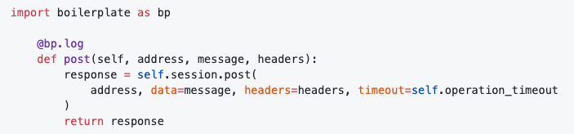
python-zeep, transports.py using our boilerplate logger
Notes:
Logical lines of code: 3

Slide 18
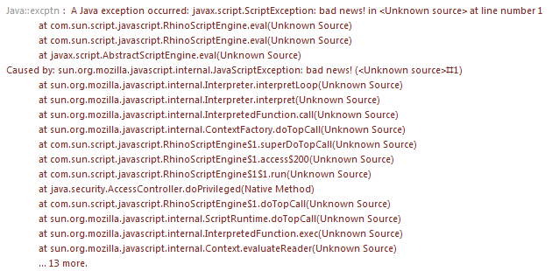
Exception Trace
Classical stacktraces: simultaneously too much and not enough information
Debuggers + breakpoints: freeze the state of a program at a breakpoint or at an exception; no contextual information

Slide 19
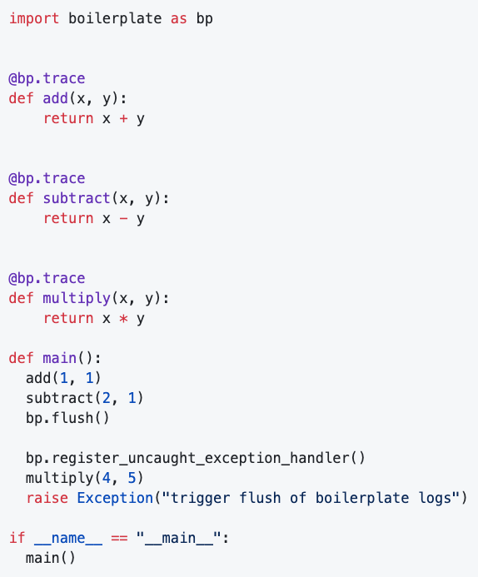
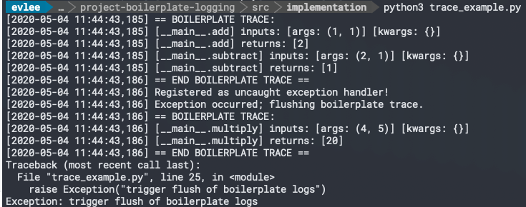
Exception trace example

Slide 20
Evaluation

Slide 21
Metrics of Success
Radon - Python tool; gathers and reports on various syntactic metrics
Raw metrics: logical lines of code (LLOC), comment lines, blank lines, etc
Cyclomatic (McCabe) complexity: number of logical decisions made
Halstead metrics: operand count, volume, difficultly, effort, time required, expected bug rate, etc
Maintainability index: Extrapolated from LOC, Halstead metrics, McCabe complexity
Notes:
@rubik -- Michele Lacchia authored Radon

Slide 22
Metrics of Success
Decrease in logical lines of code
Increase in maintainability score
Other interesting metrics:
McCabe complexity
Expected bug count
Time required to program

Slide 23
Experiment
Record desired metrics on an existing code base.
Rework code base to instead use developed boilerplate logger.
Record desired metrics after refactor.

Slide 24
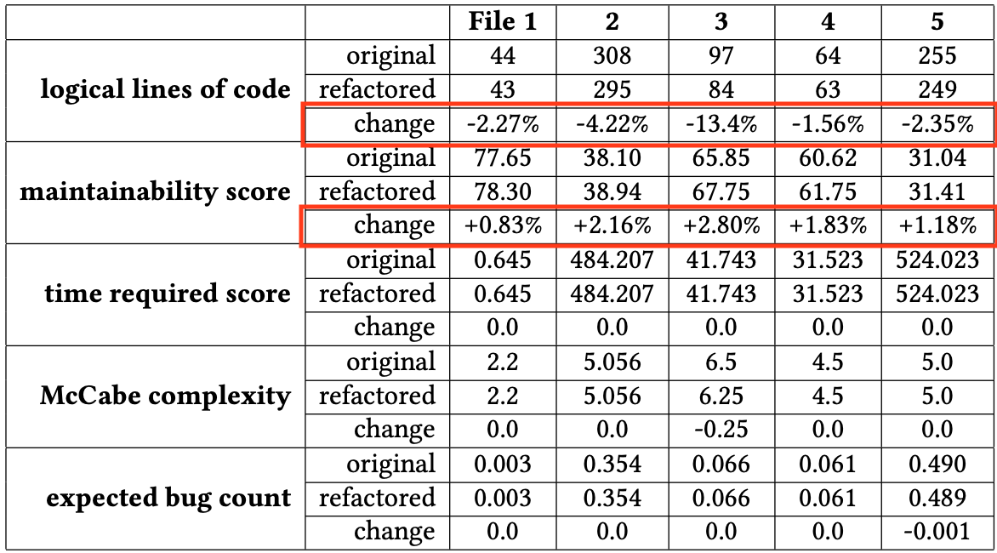
experiment results, pre- and post-refactor using boilerplate

Slide 25
Contributions

Slide 26
-38.89%
Best case decrease in McCabe complexity explored

Slide 27
Contributions
Definition of boilerplate logging
Exploration into prevalence of boilerplate logging in current state of the industry
Explanation of “hidden” cost of boilerplate logging
Implementation of boilerplate Python logging library to display ideas and areas of improvement
Case study on tangible improvements from use of implemented library

Slide 28
Questions?

